Slide 1
Assertions and Exceptional handling
By
Anirudh K M
Analyst, Mobius Knowledge Services

Slide 2
Exceptions
Exceptions are raised when an error happens in the execution of program.
The Python interpreter prints out the error along with the line number and the reason for the error.
The most common type of errors are:
SyntaxError
TypeError
IndexError

Slide 3
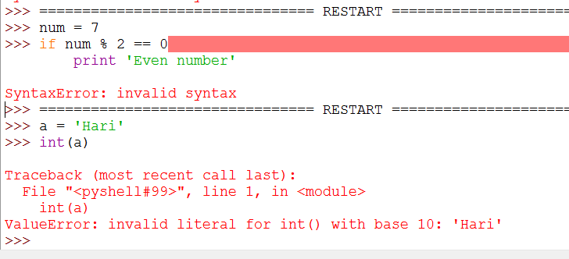
Illustration

Slide 4
Handling Exceptions
Its important to handle these errors, while we execute our script.
Syntax:
try:
Set of statements
except:
Set of statements
else: # optional
Set of statements
finally: # optional
Set of statements

Slide 5
Explanation
try: The statements under this block is executed first. If all statements are executed successfully, then the flow jumps to the else and finally clause.
except: The statements under this is block is executed when we want the error to be handled from the try block, after execution of all statements the flow jumps to the finally block.

Slide 6
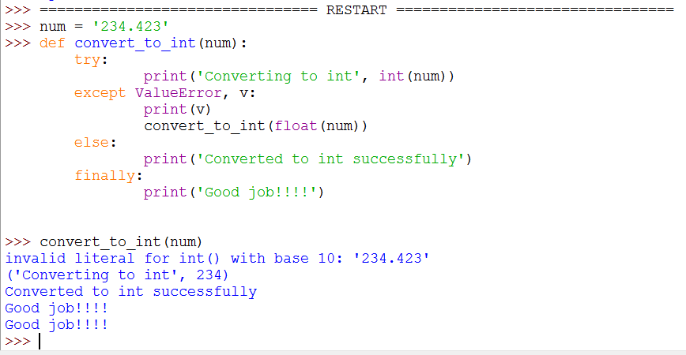
Simple Illustration

Slide 7
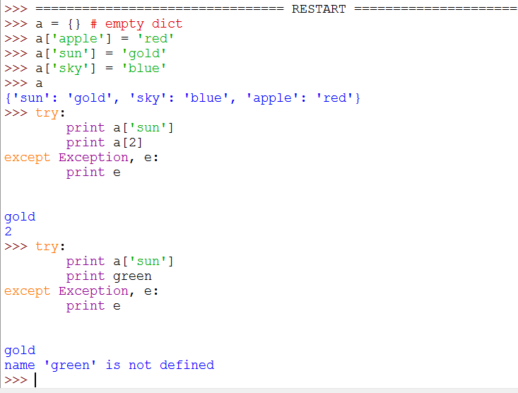
Generic exceptions

Slide 8
Handling Exceptions
We can handle multiple exceptions at a time too with the following syntax.
Syntax:
except (ValueError, TypeError ….etc), a:
print a
The ‘a’ in the except prints the error out.
Note that the errors types are enclosed in a tuple.
Also it’s a good practice to avoid using except Exception, unless its needed. You have to be as specific as possible.

Slide 9
Raising an exception
We can raise an error based on our need too without using the try and except clause.
Let us see an example how this can be done.

Slide 10
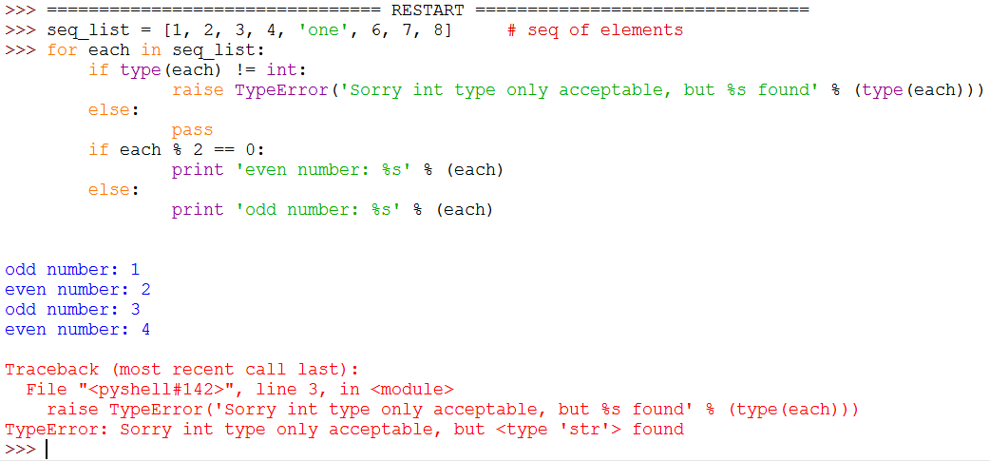
Illustration – raise an error

Slide 11
Creating our own exceptions
Like we have inbuilt exceptions which we can use, we can also create our own exceptions which we want to raise in some situations in our programs.
Now let us look at an example to understand this, which looks similar to the previous one.

Slide 12
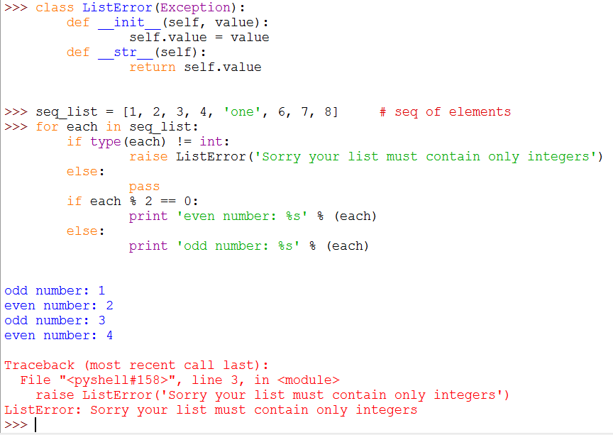
Illustration

Slide 13
Assertions
Assertions are simple expressions which helps us to assert a particular statement in our code.
If assertion is failed, AssertionError is raised.
If assertion is True, then start executing the next statement of the program.

Slide 14
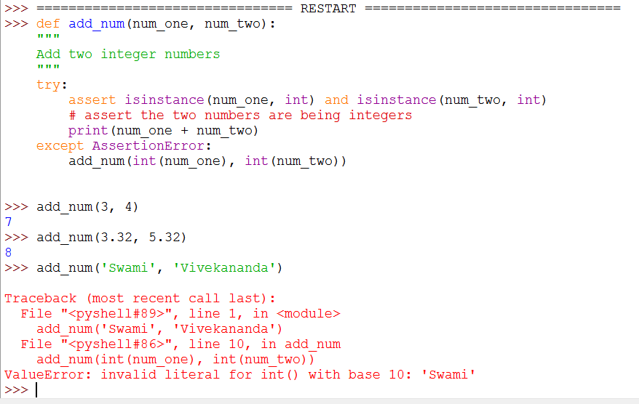
Illustration- Assertion

